Slide 1
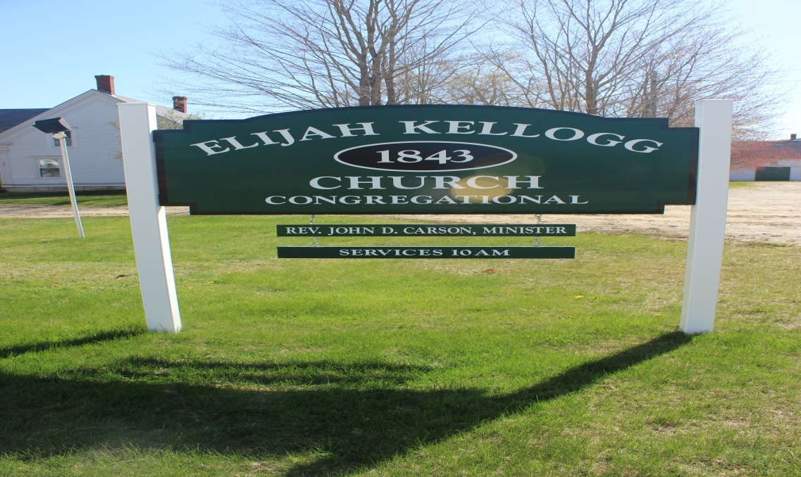

Slide 2
NOW, to what we have already achieved…

Slide 3
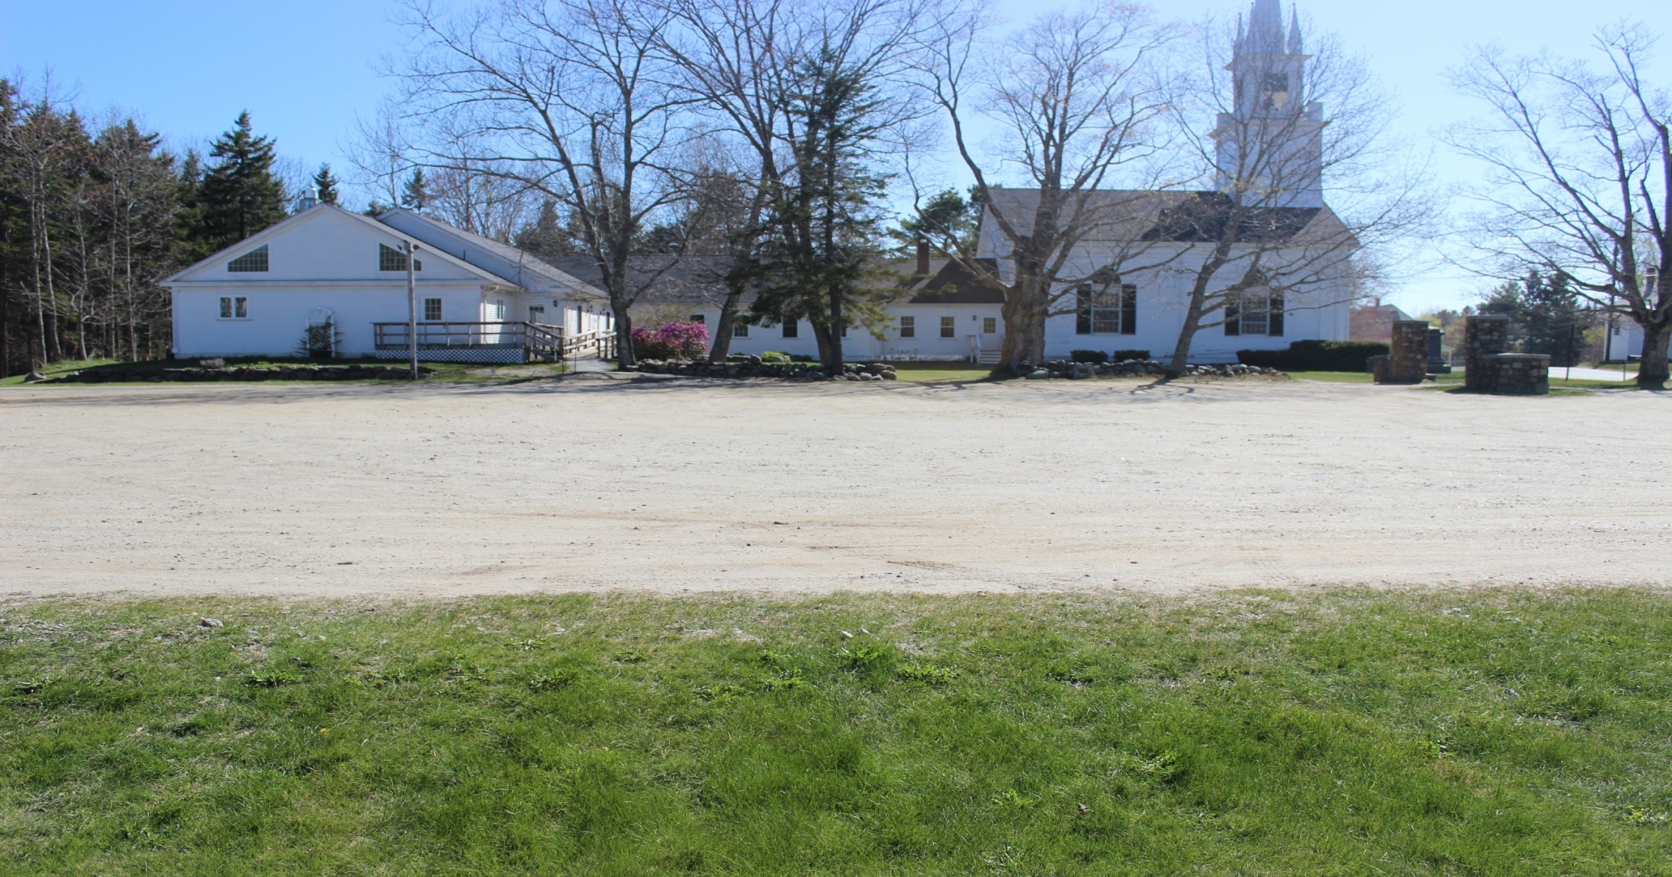
We have a new roof on sanctuary and ground work to prevent prior water issues…..

Slide 4
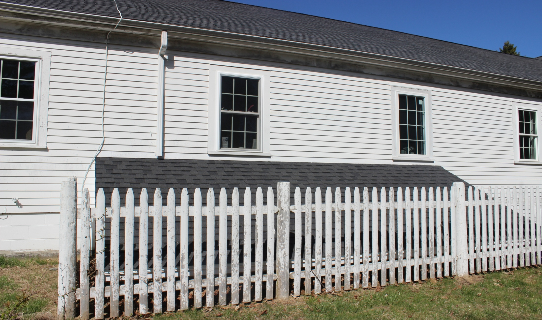
“Shedding” of water has helped….

Slide 5
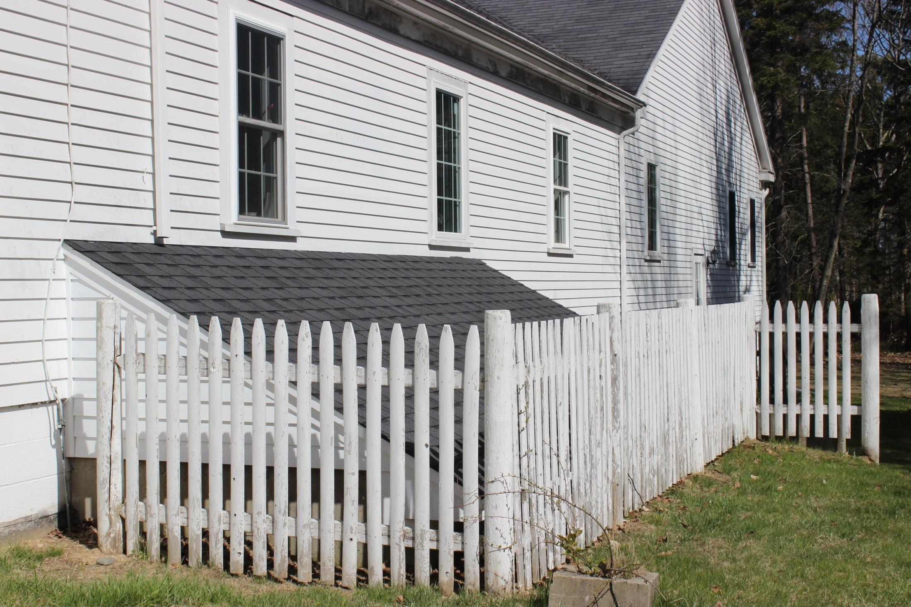

Slide 6
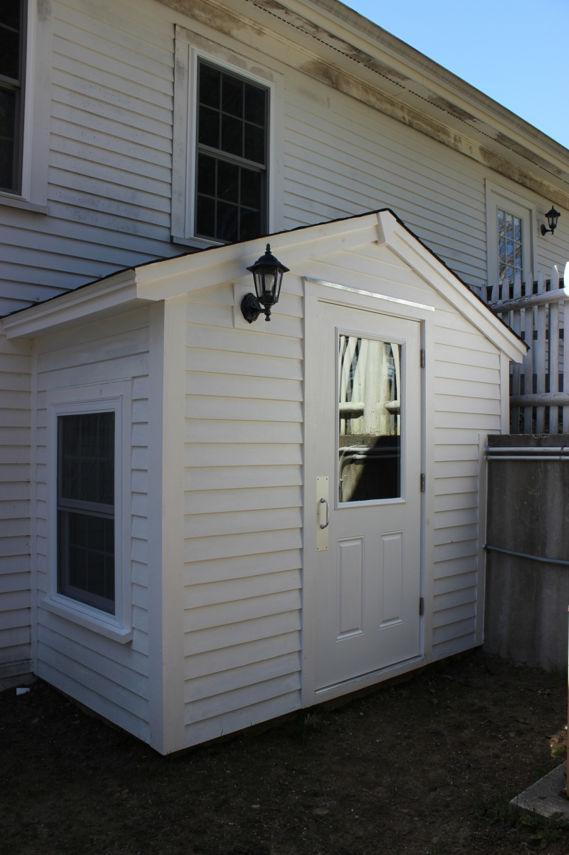

Slide 7
THE 10 YEAR PLAN FOR
NEEDED CAPITAL REPAIRS
TO THE SANCTUARY & PARSONAGE

Slide 8
NUMBER 1 PRIORITY We Must Preserve the Outside to Save the Inside

Slide 10
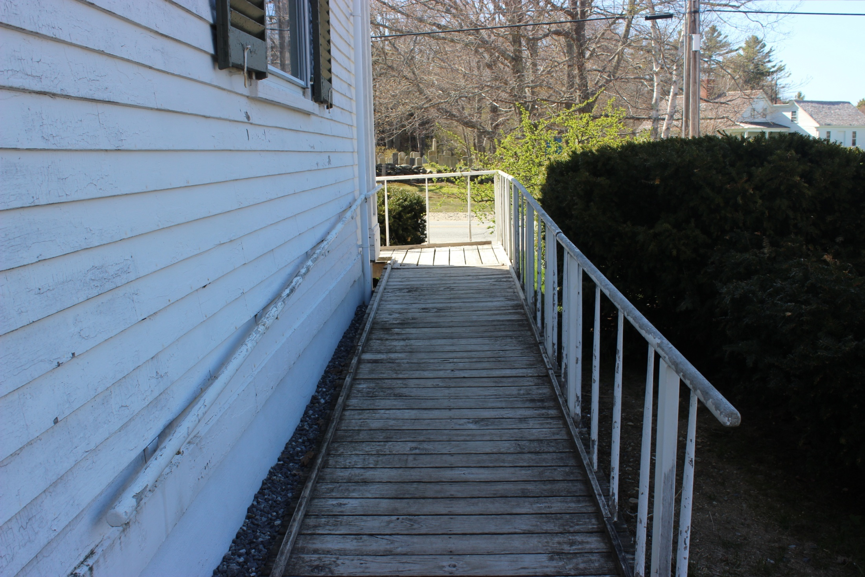

Slide 11
DON’T FORGET ABOUT THE
LEAD PAINT…..

Slide 12
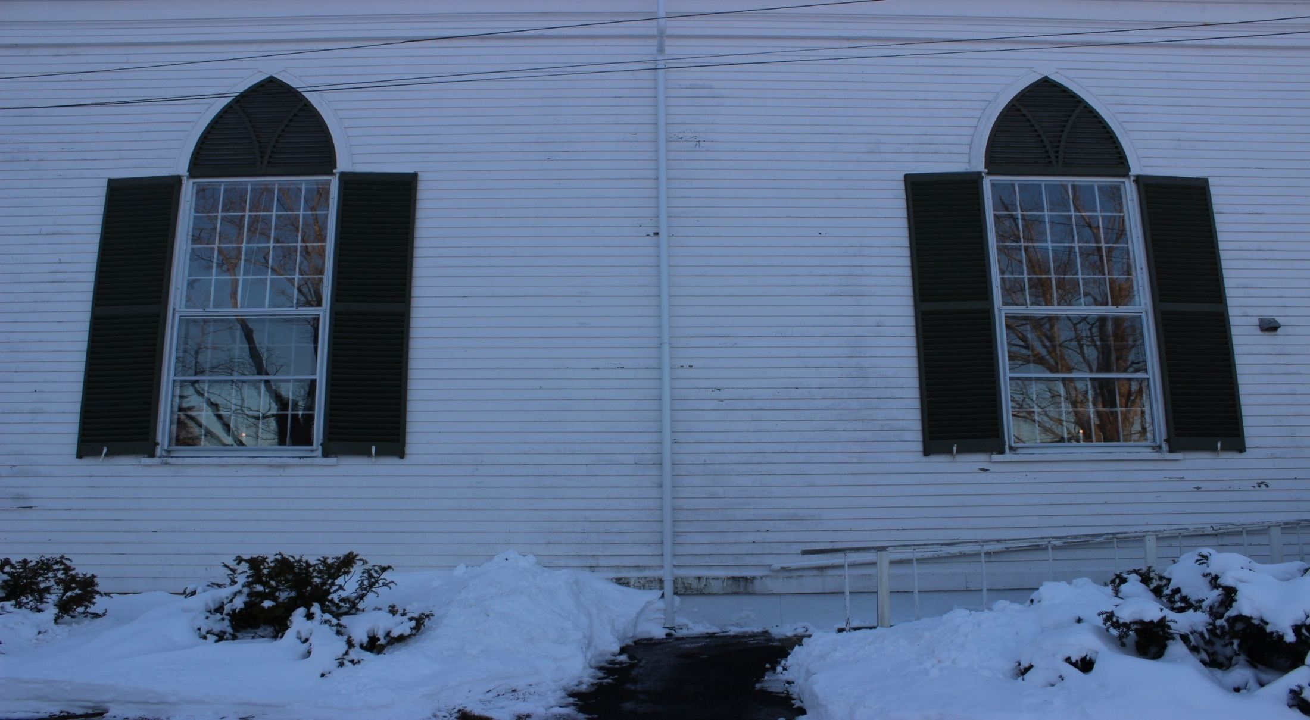
Replace the windows and insulate walls to save energy….

Slide 13
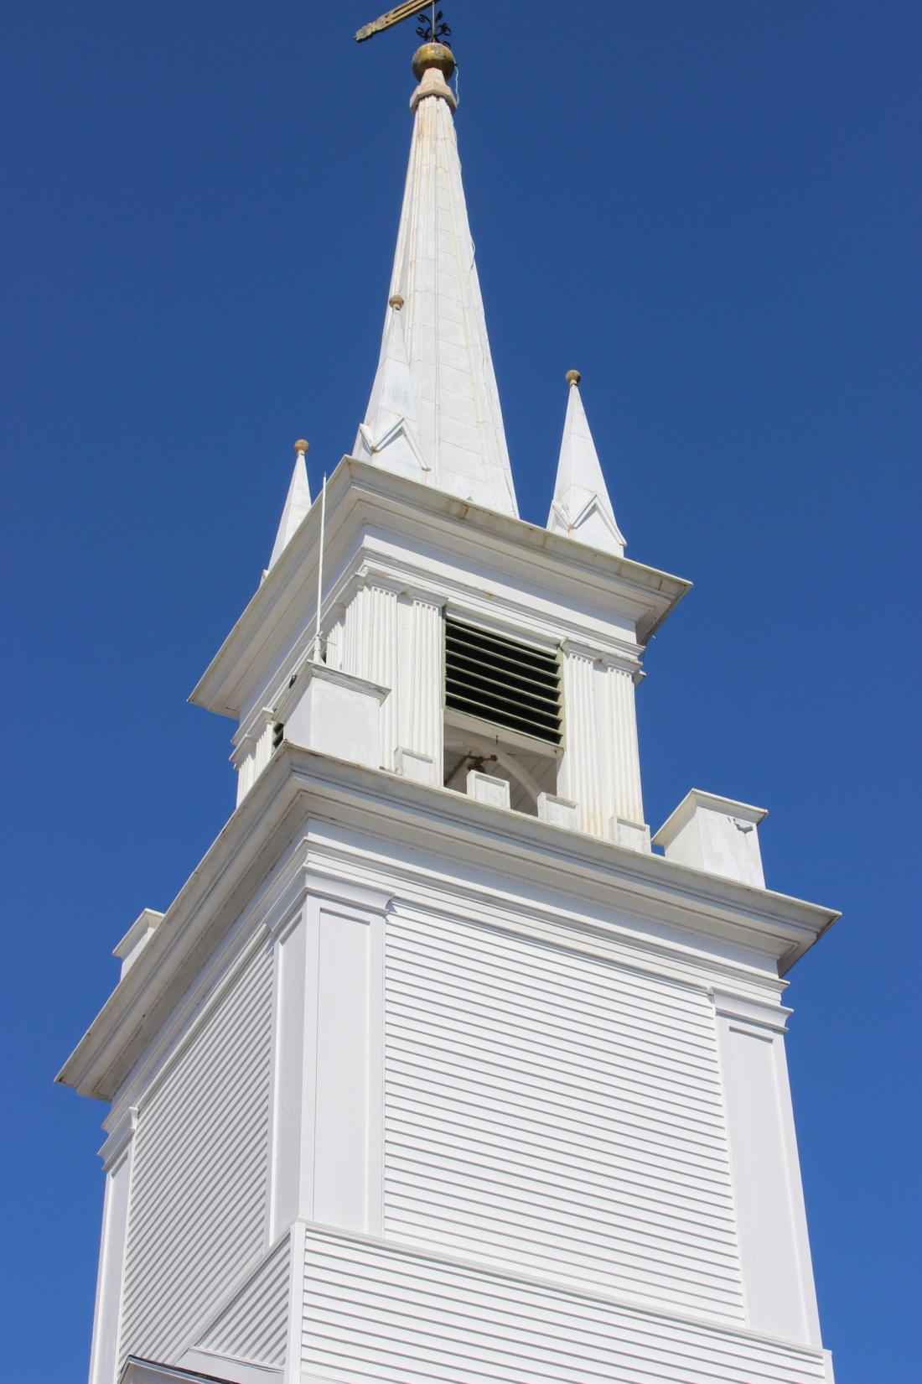

Slide 14
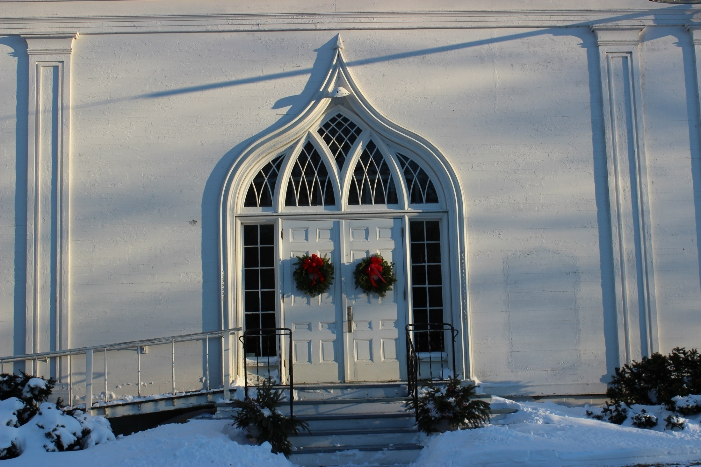

Slide 15
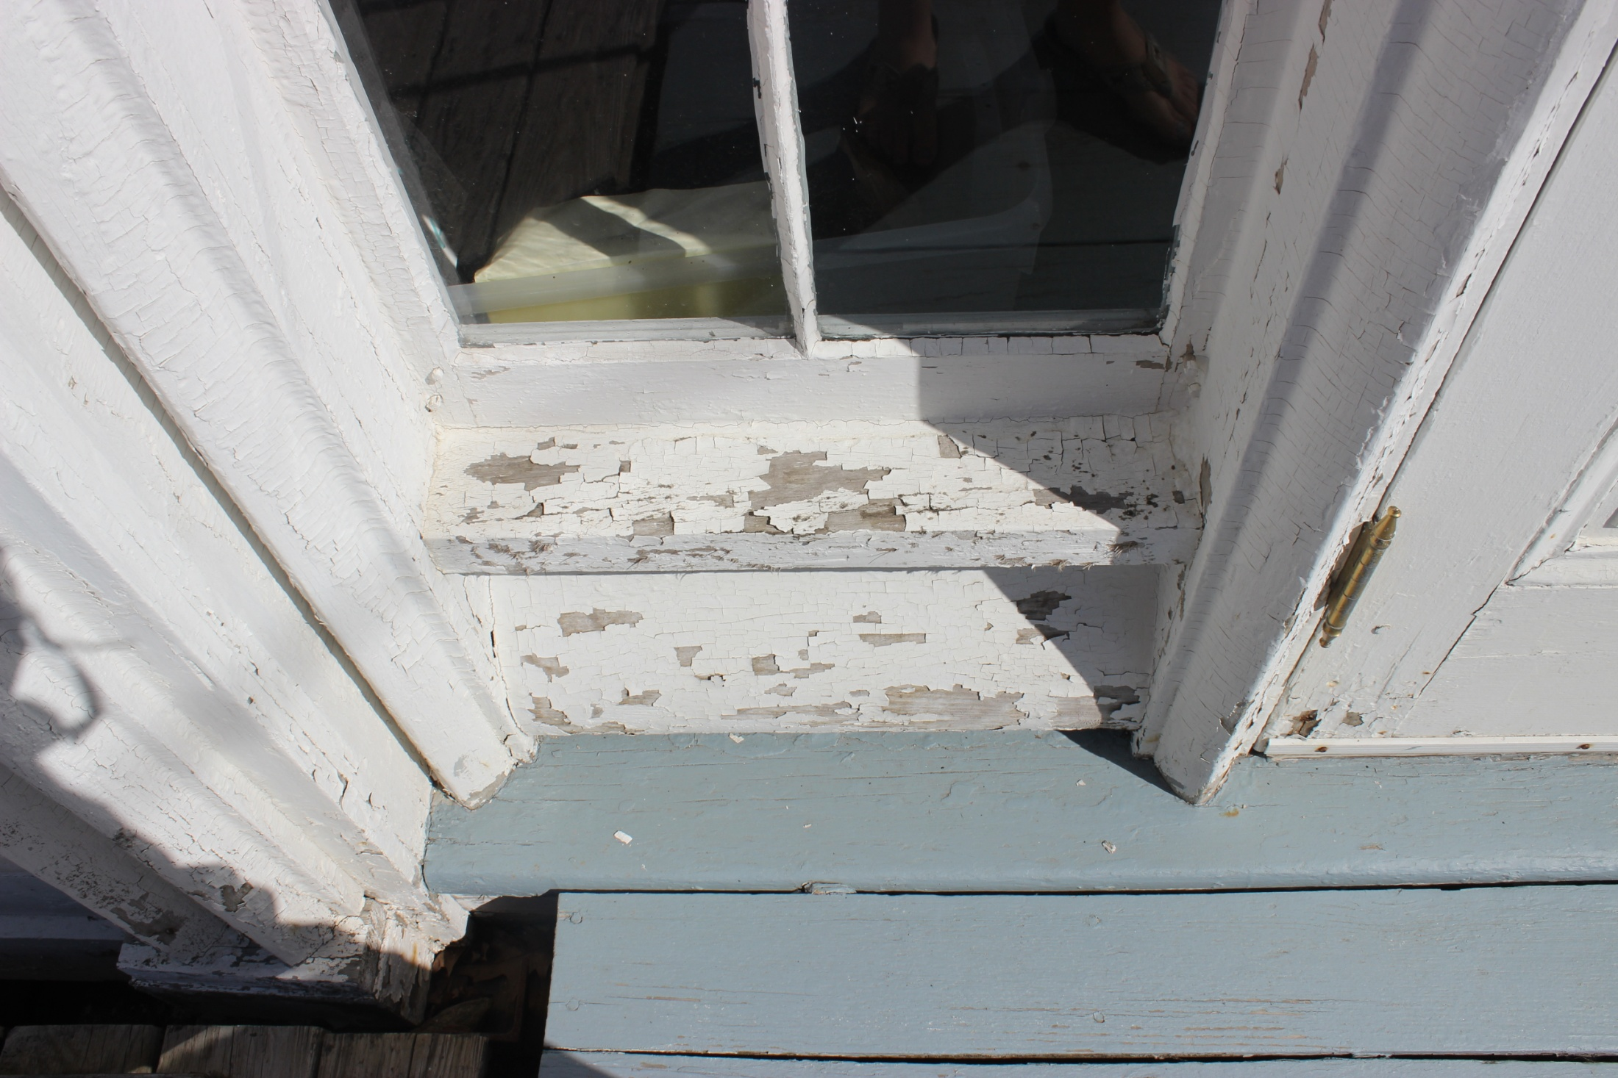

Slide 16
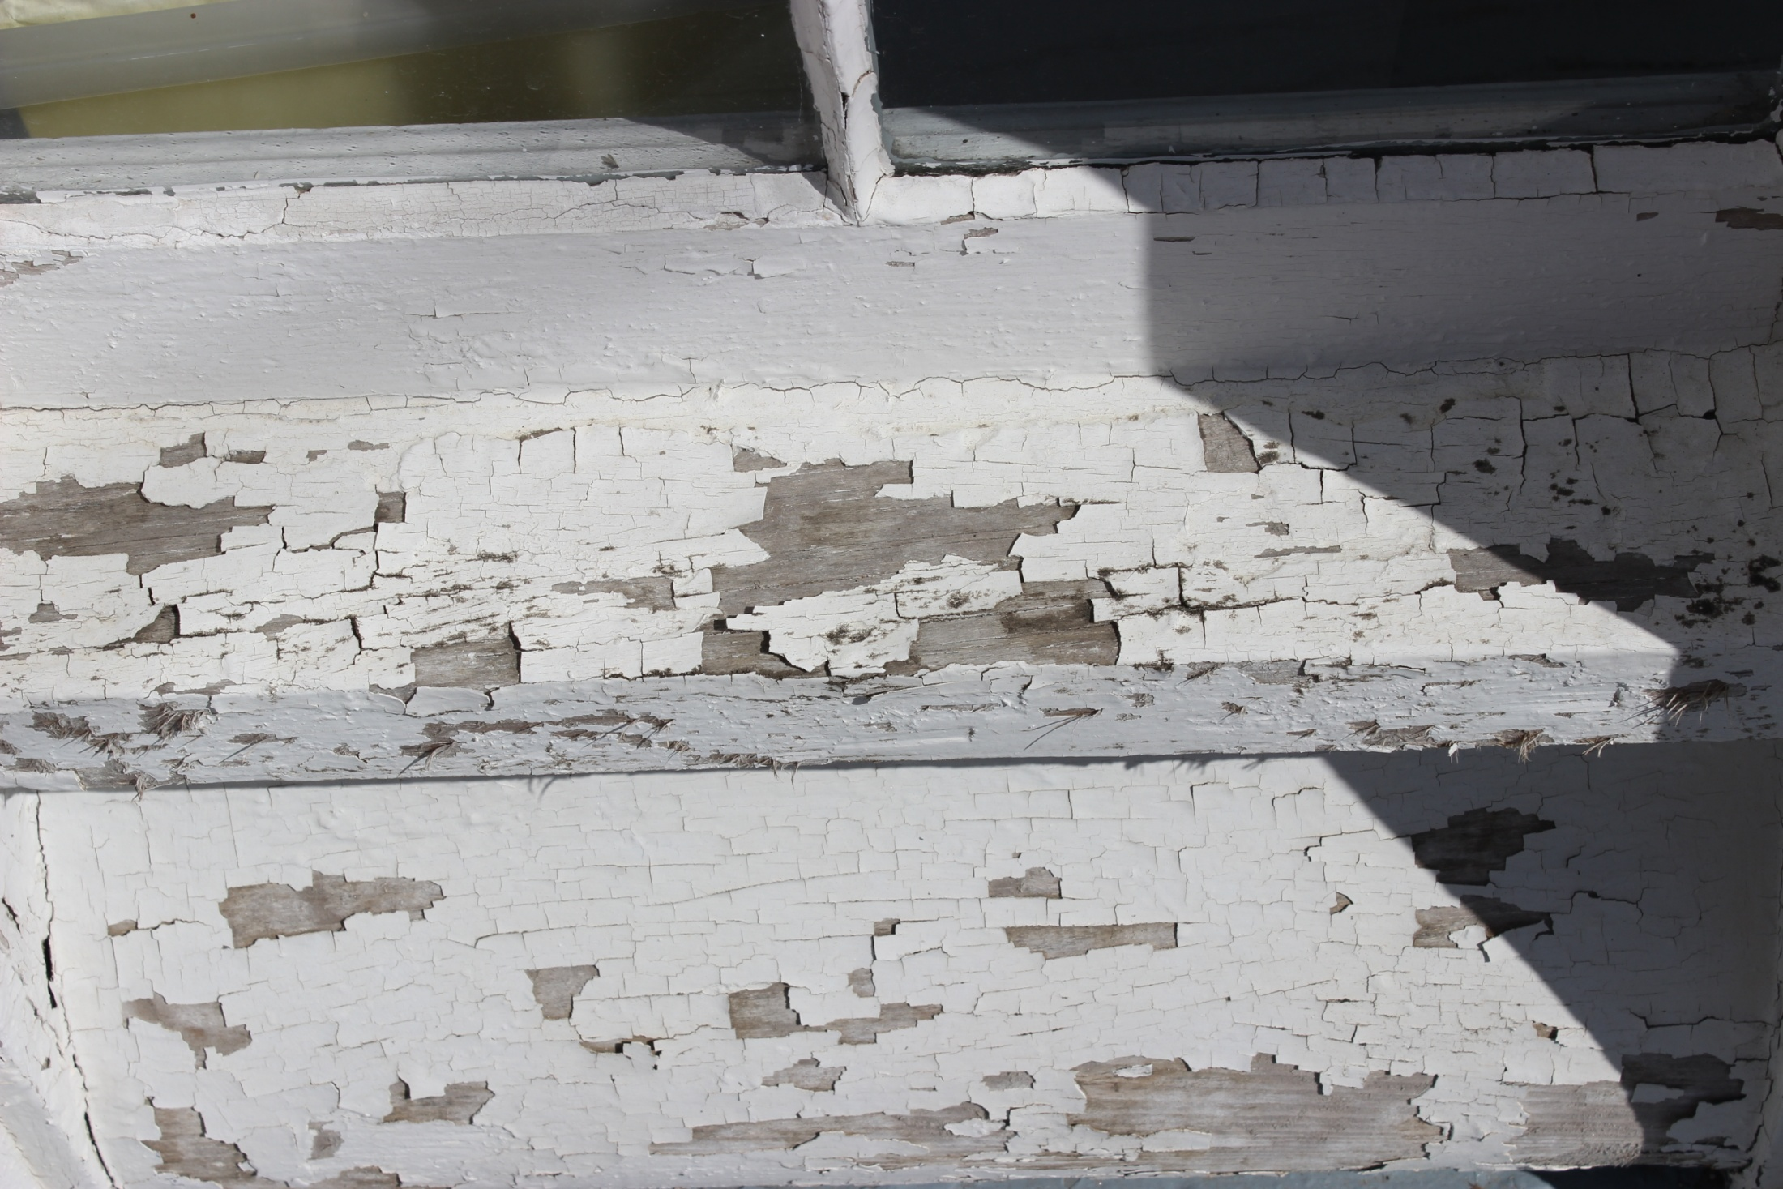

Slide 17
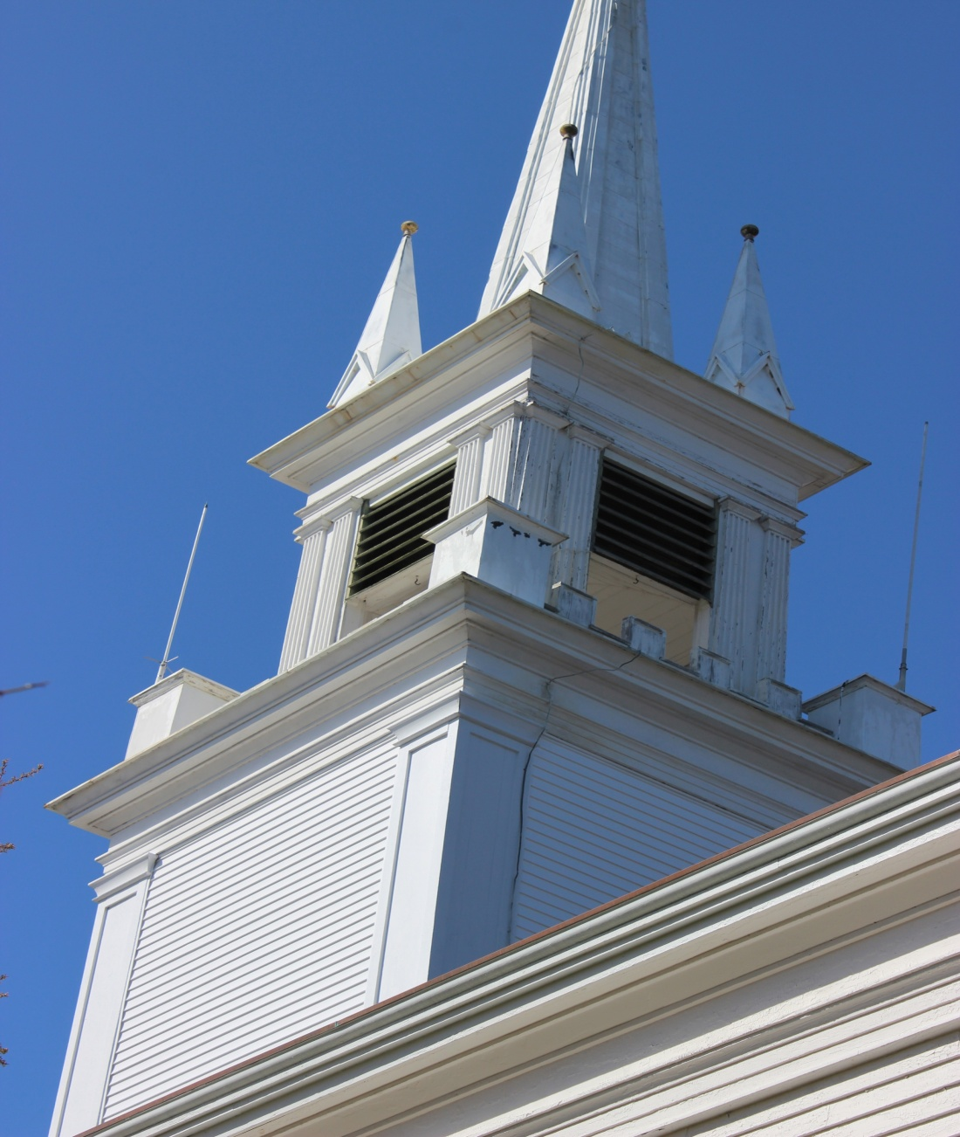
STAIN THE STEEPLE

Slide 18
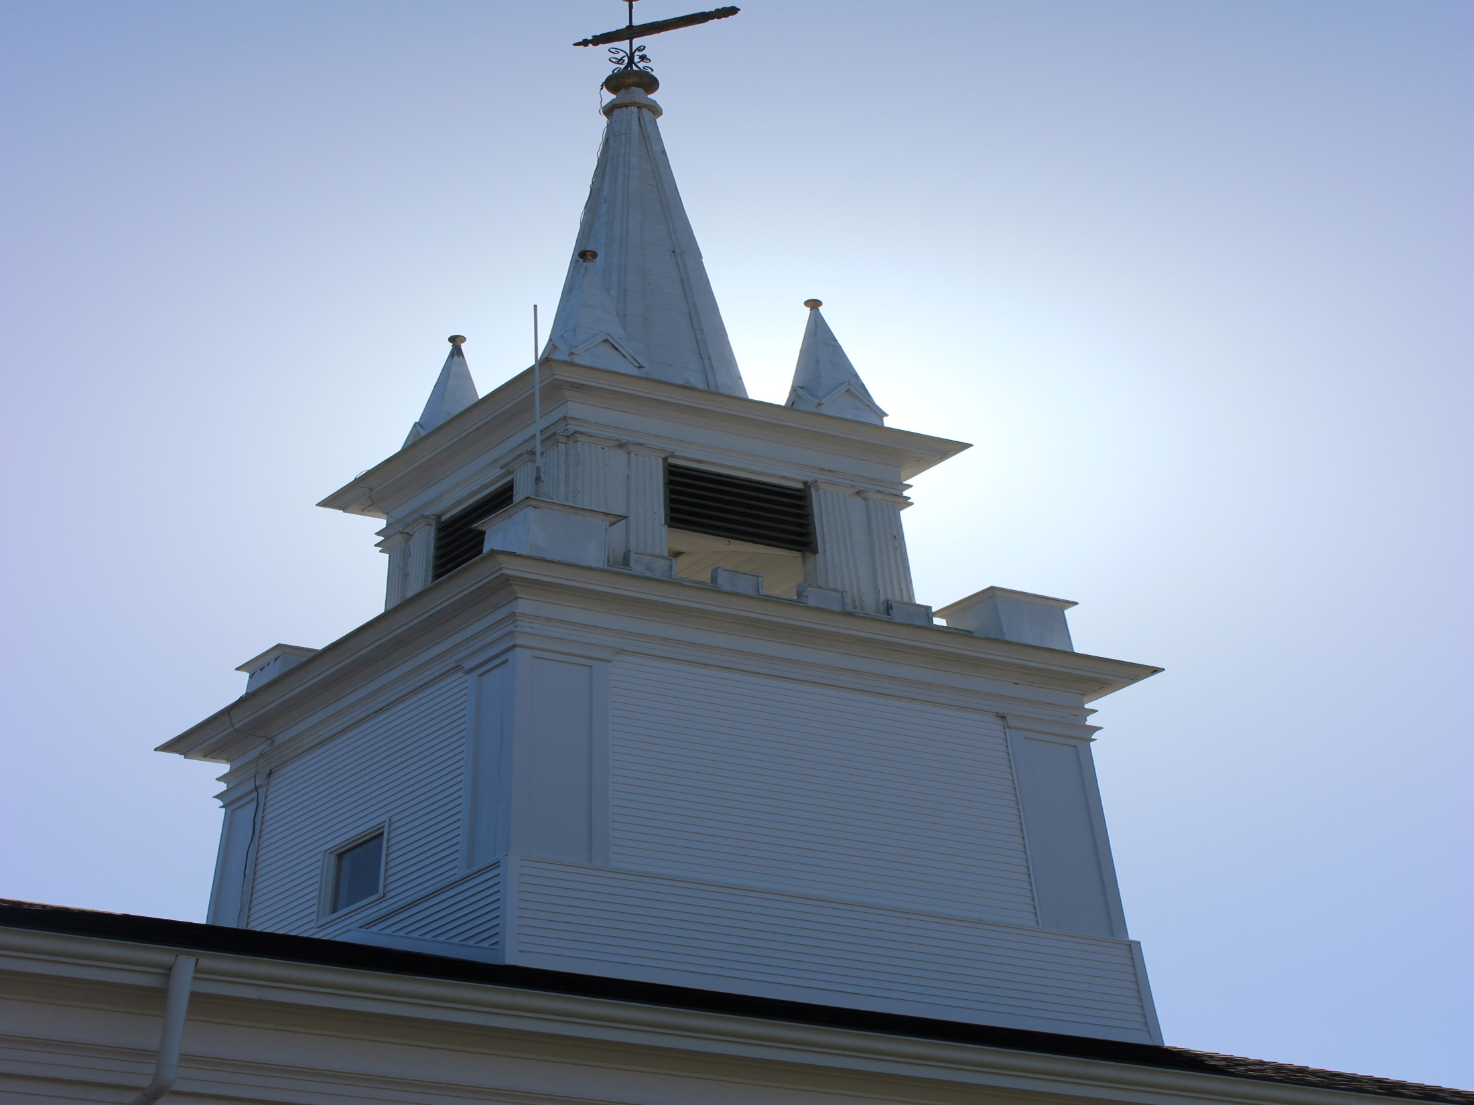

Slide 19
By the way……….
Much of this also needs to be done at the parsonage………….

Slide 20
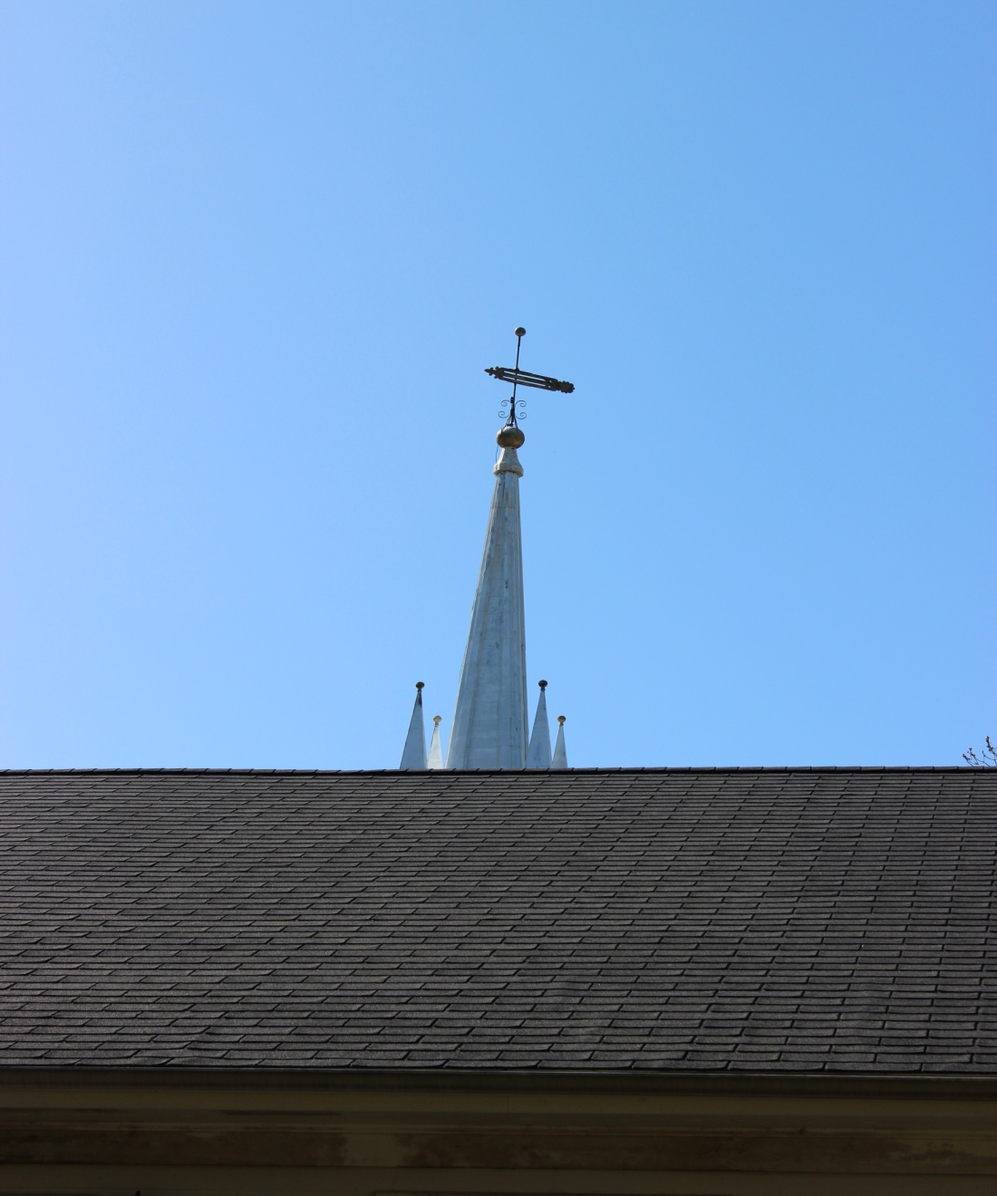
Replace the roof in fellowship hall….

Slide 21
And let’s not forget the….
………………………………..

Slide 22
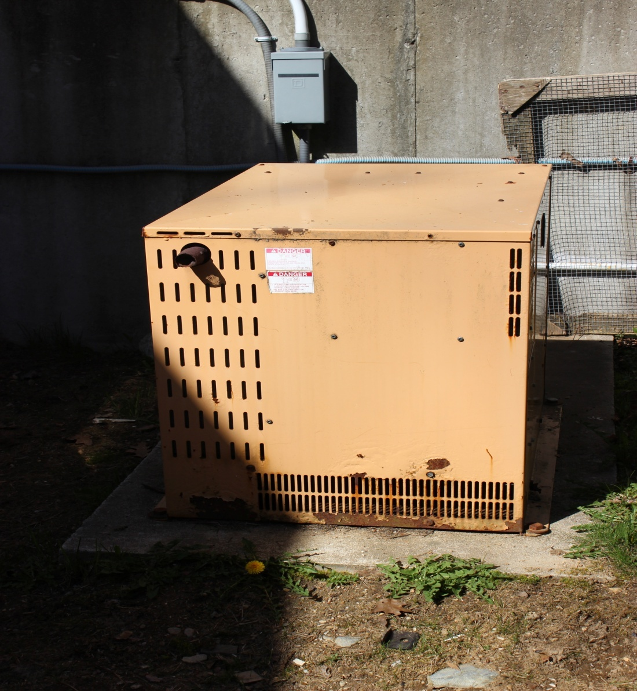
Need to replace generator…eventually!

Slide 23
We also need to over the next 10 years:
-replace the carpeting in fellowship hall
-repair and paint ceiling in fellowship hall
-need emergency lighting for sanctuary
-replace well pump
-replace septic field
-replace pressure tank
-replace sanctuary carpet
-replace bell wheel
-finish old basement

Slide 24
